Slide 1



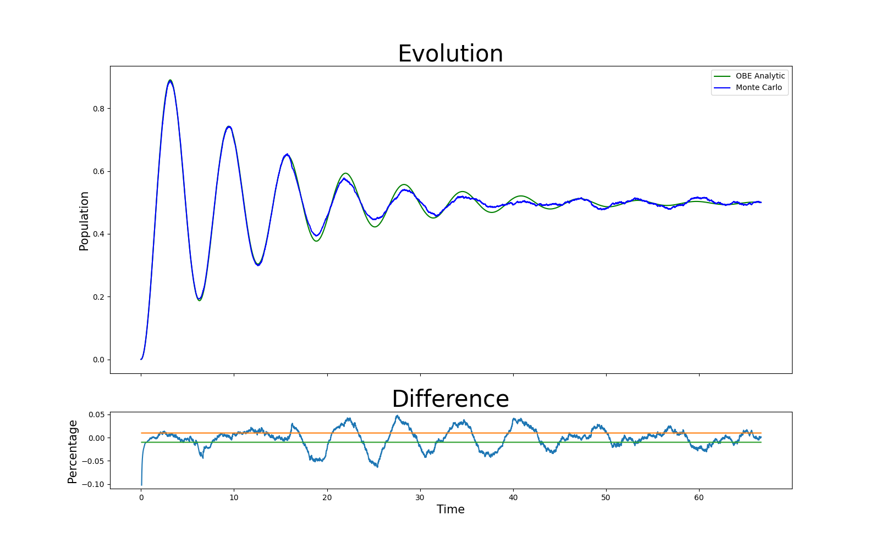

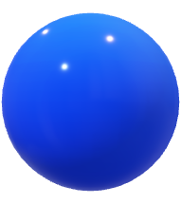

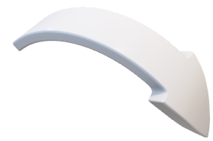



Qubit Dynamics: Introducing to Future Computing Technology
Introduction(This part should give a brief explain about what is quantum computing and what is the qubit)
In quantum computing and information, a qubit is a key building block that represents a two-level quantum system. The property that it can state in a superposition of state 0 and state 1 provide an outstanding ability in storing data in limited space. The Rabi frequency, Ω_R, is the defining characteristic that measures the speed at which qubit states transition due to the influence of external fields.
What is Qubit:
Qubit, also known as Quantum bit, is a concept in quantum physics. It is a particle that exists in a superposition state. Throw a classic coin, the result would be either face up or face done. However, a ‘quantum coin’ could represent both face up and face done.
How to simulate a qubit in classic computer:
Matrix is one of the best way to describe a quantum particle in a classic computer. As for the previous concept of “spin up” and “spin down”, they are represented by (0 1) and (1 0) prospectively. Any operation are represented by operators, for example the position operator times the matrix gives the position of the qubit, and the Hamiltonian operator, which is the key operator discussed here, results the effect from a laser field to the qubit.
Connection with other projects
(This part should state the related part of technologies )
Error corrections
Superconductivity with quantum computing
Latest News:
(This part should contain some encouraging developments in the recent world.)
Face Down
Face Up
Face Up and Down
Similarly, as a common bit could only represent 0 or 1 in binary system, a quantum bit can represent both 0 and 1 state. Represent this 0 and 1 as wave, and call 0 “Spin down”, call 1 “Spin up”, we get the basic quantum represent for a qubit.
Monte Carlo Algorism
--simulation
Optical Bloch Equation
--numerical solution
Monte Carlo simulation is a way to simulate a random phenomenon. It has been regarded as one of the best way do describe random phenomenon using classical way. The key features of this simulation is comparison, iteration, .At a specific time, a random number is generated, and one comparison is made due to some rules. After the comparison, the function steps to the next time after a short period δt. The hole Monte Carlo simulation is the repetition of these steps
Optical Bloch equation is the analytical way to calculate the evolution of the particles.
Spin Up
Spin Down
Superposition state
The property of qubit enables it to contain more information than a classic bit. It has been given a huge perspective in further usage. One typical is the storage. Comparing to 2 classic bits which can store 2×2 bits of message, 2 qubits can store 2 2 bits of message with the combination [up, up], [up, down], [down, up], [down, down]. The advantage of using qubits overkills classic bits as the number of calculating units increase. Quantum Supremacy is used to describe this huge difference in performance, even though currently there is no generally accepted evidence for which association has proven this idea.
references

